Slide 1
UNIT #10 SLIDES
Vocab, notes, & study guide

Slide 2
VOCAB LOG – 10.1, 12/19
ON NEW SHEET OF PAPER, LABEL “VOCAB LOG #10” AT TOP. BELOW, LABEL TODAY’S VOCAB AS “10.1 – 12/19.”
CONSTITUTIONAL LAW: deals w/ the formation, construction, & interpretation of a constitution
STATUTORY LAW/STATUTES: written laws, passed by legislative branch
ADMINISTRATIVE LAW/REGULATIONS: enacted by executive agencies, usually deal w/ those agencies’ day-to-day matters
COMMON LAW/PRECEDENT: enacted as a result of court cases
STARE DECISIS: when courts applies a ruling from a previous case to future cases
DUE PROCESS: steps govt must take to exercise the law properly & protect the rights of the accused
DOUBLE JEOPARDY: being retried for a case for which one was previously found not guilty

Slide 3

CIVICS & ECONOMICS
UNIT #10: LAW & JUSTICE
10.1
CAMPING ON SNAELFELLSNUS PENINSULA IN ICELAND

Slide 4
Development of Law in American Society:
Jurisprudence
Justice vs. Fairness

Slide 5
INFLUENCES OF U.S. LAW

Slide 6
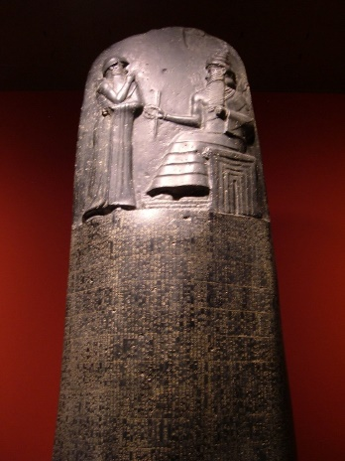
Code of Hammurabi: 1700s BCE
First known system of written law
Over 280 harsh laws
Legal Code – statements of what is legal & illegal
Ten Commandments: 1200s BCE
Found in the Bible
Followed by Hebrews in ancient Palestine
Moral Code – statements of what is right & wrong
Notes:
Created about 1760 BC
The first example of the legal concept that some laws are so basic as to be beyond the ability of even a king to change
Because Hammurabi had the laws (282) inscribed in stone, they were unchangeable
http://www.youtube.com/watch?v=ZO1r2dvLSKo

Slide 7
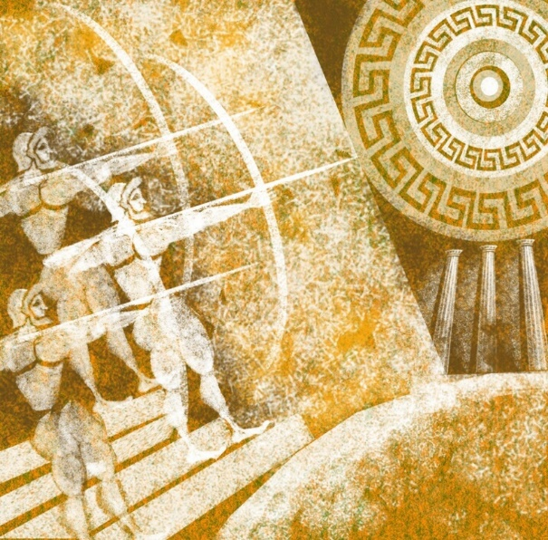
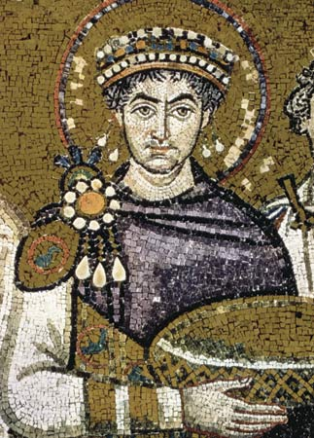
Draconian Law: 600s BCE
First written law of Athens, Greece
Very harsh
Retribution - revenge, punishment
Legal Code - what is right & wrong according to law
Justinian Code: 500s CE
Harsh Roman law
Emperor Justinian I compiled & simplified all of the previous Roman codes of law in A.D. 533

Slide 8
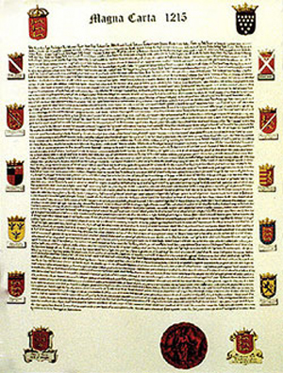
British Common Law: 1100s AD
Most important source of American law
Common law is law based on previous court decisions
Established in many of the English colonies
Magna Carta: 1215
Limited powers of the English king
Granted new rights & laws to English nobles

Slide 9

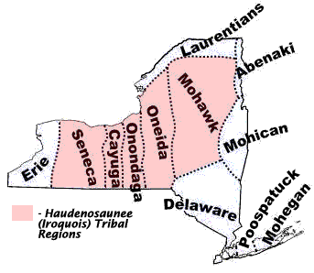
English Bill of Rights: 1689
Further restricted powers of British monarchy
Holds many of the ideas that we now have in our Bill of Rights
  Freedom of Speech
  Right to fair trial
  No cruel & unusual punishment
The Iroquois Constitution: 1500’s
Oral constitution of a confederacy of 6 Native American tribes
Inspired Benjamin Franklin & James Madison when writing U.S. Constitution
Notes:
Date: A.D. 1689
It asserts the Subject's right to petition
Subject's right to bear arms
It also sets out certain constitutional requirements where the actions of the Crown require the consent of Parliament
This provided a strong central gov’t= rise of anti-feds in America & push for BOR.
http://www.youtube.com/watch?v=yqAX9aS6LSQ

Slide 10
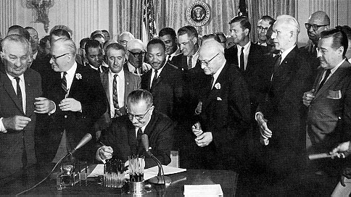
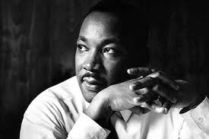
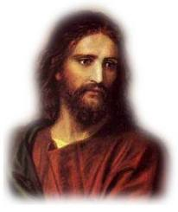
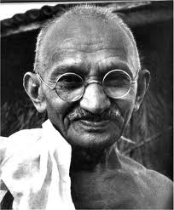
Civil Rights Act of 1964
July 2, 1964
Outlawed discrimination based on race, color, religion, sex, or national origin
prohibited discrimination in public facilities, in government, & in employment
It became illegal to compel segregation of the races in schools, housing, or hiring
Civil Disobedience:
Non-violent protest to influence society or govt.
Examples: Martin Luther King Jr., Gandhi, Jesus.
Notes:
http://www.youtube.com/watch?v=ZaRUca7FyAc

Slide 11
SOURCES OF U.S. LAW

Slide 12
In our govt there are 4 main sources of laws:
Govt agencies may use each one of these when operating

Slide 13
Constitutional Law
Some parts of Constitution give specific laws that apply everywhere in the U.S.
Ex.: Constitution gives Congress power to:
Establish Post Offices & post roads
Make all laws that are necessary & proper for executing this task
Statutory Law: Statutes
The Constitution gives Congress permission to pass laws about a limited number of topics.
Ex.: Congress passes laws to:
Establish the USPS
Direct the Postal Service to provide efficient service at fair rates
Authorize Postal Service to adopt rules & regulations

Slide 14
Administrative law: Regulations
Congress has power to pass laws, not to carry them out.
They give each agency the power to create its own rules or regulations.
Regulations have power similar to a law.
Some regulations say what people can and cannot do
Ex.: USPS adopts regulations to:
Establish rules for daily operations at Post Offices around the country
Limit what people allowed to do on Post Office property
Create special postal programs
Judicial law: Precedents
The judicial system hears cases about violations of the Constitution, the Code, & the Regulations.
Code & Regulations cannot violate the U.S. Constitution
The courts’ interpretation of the Constitution, the Code, & the Regulations is like an extra “law”

Slide 15
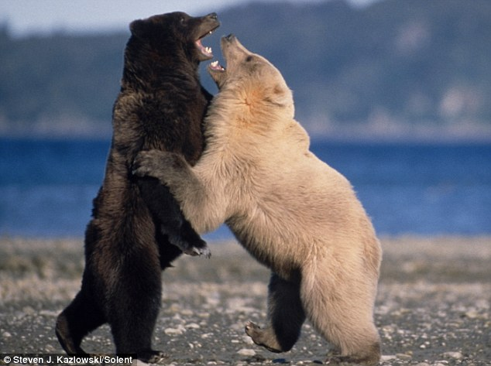
Views of U.S. Law
Laws are supposed to:
  Protect human rights
  Promote fairness
  Resolve conflicts
  Promote order and stability
  Represent the will of the majority
  Protect the rights of the minorities
The United States System
*U.S. court system is called an ADVERSARIAL SYSTEM*
An adversary is an opponent: (Plaintiff v. Defendant)
Courtroom puts people against one another

Slide 16
PROTECTIONS IN THE U.S. CONSTITUTION
Article I, Section 9 grants citizens the right of habeas corpus (right to have their day in court to have explained to them of what they were accused)
The Fifth & Fourteenth Amendments guarantee citizens due process of law, that government must follow certain steps & properly exercise the law toward the accused in order to protect citizens’ rights to life, liberty, & property
Fourth Amendment protects against “unreasonable & search & seizure,” requiring authorities to obtain a search warrant – specifying the exact place to be searched & which objects may be seized (RECALL: upheld in Mapp v. Ohio SCOTUS case)

Slide 17
PROTECTIONS IN THE U.S. CONSTITUTION
Fifth Amendment: right to trial by jury, protection from double jeopardy (person tried for a crime & found not guilty may not be retried for the same crime), & right of citizens against self-incrimination (testifying against oneself) [RECALL: upheld in Miranda vs. Arizona SCOTUS case]
Sixth Amendment: due process of law in criminal cases
  to be informed of accusation
  to hear & question witnesses
  to be able to subpoena witnesses (call them to court)
  to be represented by an attorney (RECALL: upheld in Gideon v. Wainwright SCOTUS case)
  to have a speedy & public trial by an impartial (non-biased) jury

Slide 18
PROTECTIONS IN THE U.S. CONSTITUTION
Seventh Amendment: due process of law in civil cases
Eighth Amendment: outlaws cruel & unusual punishment & punishments that are disproportionate to the crime (ex.: life-sentence for shoplifting)
Fourteenth Amendment: due process rights for all, or equal protection of the law [RECALL: upheld in Gideon v. Wainwright SCOTUS case)

Slide 19
VOCAB LOG – 10.2, 01/04
BELOW 10.1 VOCAB, LABEL TODAY’S VOCAB AS “10.2 – 01/04.”
PROSECUTION: in criminal cases, govt representative that starts legal proceedings against a suspect
PLAINTIFF: in civil cases, side/party that files a lawsuit
DEFENDANT: side/party whom a case is brought against
BURDEN OF PROOF: side/party that must prove their case
VOCAB SLIDES WILL STAY UP ONLY UNTIL 7:22AM
If you finish early, make sure you have YELLOW REVIEW SHEETS FOR UNIT #6 & #7

Slide 20
CIVICS & ECONOMICS
UNIT #10: LAW & JUSTICE
10.2
CAMPING ON SNAELFELLSNUS PENINSULA IN ICELAND

Slide 21
Types of Law

Slide 22
Common Law
Using previous court cases to determine law
Example – If restaurant owner denied an African-American service, courts would look back to the decision in the Heart of Atlanta Motel v. U.S. case
Began in England
Deals with the use of precedent
Covers nearly all aspect of human life
Judge-made law that has developed over centuries
Enforcement through the judicial system
22

Slide 23
Criminal Law
Laws that seek to prevent people from deliberately or recklessly harming each other
Felonies & misdemeanors
Types of Criminal Cases
Misdemeanors - Lesser crimes
Felonies - Serious/violent crimes
Crimes against Property
  Larceny, Burglary, Robbery
  Vandalism, Fraud, Embezzlement
Crimes against People
  Murder, Manslaughter
  Rape, Kidnapping, Assault

Slide 24
Civil Law
Dispute between two or more people usually involving money or family court
Examples: Divorce, Child Support, Car accidents (that do not involve a crime), Alimony, Abuse
Major Players in the Courtroom
Plaintiff: In Civil Cases, injured party who brings action against alleged offender
Defendant: Indv whom a claim is made against in court
  In Civil Cases, defendant is person being sued.
  In Criminal Cases, the defendant is the person charged with committing a crime.

Slide 25
Major Players Continued:
Prosecutor – Criminal Cases: Legal representative of the Government.
  Prosecutor is the U.S. Attorney in Federal Courts, the District Attorney in State Courts
Public Defender: Court-appointed representative for impoverished defendants that cannot afford their own attorney.
Bailiff: An officer in State and Federal Courts whose duties include keeping order in the courtroom and guarding prisoners or jurors in deliberation (discussion).

Slide 26
TWO TYPES OF JURIES
JURY
U.S. Citizens listen to cases to determine a person’s right to property, right to freedom, or in capital cases, right to life
    Generated lists of jurors come from voter registration and drivers’ license lists.
GRAND JURY: CITIZENS DECIDE WHETHER OR NOT TO INDICT PERSON. THEY DO NOT TAKE PART IN THE TRIALS, ONLY IN THE INDICTMENT PROCESS (CHARGING THE PERSON WITH THE CRIME)
PETIT “TRIAL” JURY: CITIZENS WHO SERVE AS FACT FINDERS DURING TRIALS (rule as guilty or not-guilty)

Slide 27
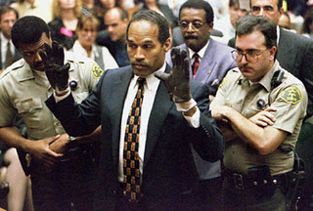
Burden of Proof
Burden of refers to the party that has the job of proving the other person guilty
We are “innocent until proven guilty”
Criminal:
Civil :
prosecution has the burden of proof
  defendant must be proven guilty
  “beyond a reasonable doubt”
plaintiff has burden of proof
defendant must be proven guilty “with a preponderance of evidence”
  One side must present, more testimony, exhibits & evidence than the other side

Slide 28
Criminal Punishments
Penalties vary according to seriousness of crime committed (8th Amendment)
Crime against people will carry greater punishments
Role of Punishment
REHABILITATION: Goal is to help criminals to re-enter society & be productive
DETERRENCE: Keep others from committing crimes
Indeterminate Sentencing
Judge gives a range of sentences
Depends on judge, politics, etc.
MANDATORY SENTENCING/ 3 STRIKE LAWS: 3 times charged = jail time
PAROLE: Early release from jail

Slide 29
Civil Court Procedure
Can take years to settle in court b/c of so many cases; most cases settle out of court
Steps:
File a COMPLAINT: Formal statement naming plaintiff, defendant, and nature of lawsuit
SUMMONS is issued: Sent to the defendant to inform them of the case
Attorneys exchange PLEADINGS: Complaint & defendant’s answer together
Court PRESENTATIONS: Attorneys present cases
Judge or jury begin DELIBERATIONS
“Preponderance of evidence”
Whoever has best evidence wins
VERDICT is issued
Plaintiff wins = remedy set
Plaintiff loses = gets nothing and pays court costs

Slide 30
Criminal Court Procedure
Steps:
Police ARREST (or book a suspect)
PRELIMINARY HEARING: suspect appears before a judge & bail is set
INDICTMENT: jury or judge hears evidence & formally charges suspect
ARRAIGNMENT: suspect is formally presented w/ charges & asked to plea (guilty or not-guilty)
  If suspect pleads guilty (often on a lesser charge), they can accept a plea bargain
  If suspect pleads not guilty, a trial date is set
TRIAL: prosecution & defense present case to jury/judge
VERDICT: jury or judge reaches a decision
  Acquittal: defendant found not-guilty & goes free
  Sentencing: defendant found guilty, & judge sentences the defendant

Slide 31
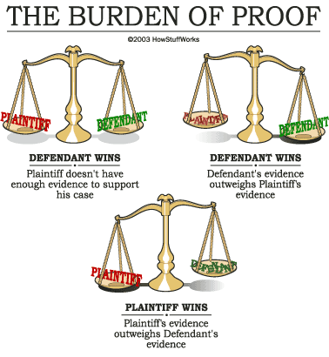
Civil Court Procedure

Slide 32
Administrative Law
Incl. rules & regulations made by govt agencies
Example: Environmental Protection Agency creates a regulation banning certain types of pollution
Statutory Law
Deal w/ statutes (state law) that regulate behavior
Ex.: Speed limits, food inspection processes, minimum ages for work permits, driver’s licenses, voting requirements, etc.

Slide 33
Constitutional Law
Laws written in Constitution must be followed
Example – Rights of the accused, such as
  Habeas Corpus
  No Double Jeopardy
  Hear & Question Witnesses
  Impartial Jury
International Law
Made up of treaties, customs, & agreements with other nations
If broken, defendant can go to the World Court (est. by United Nations in 1946)
HAVE OUT THE FINAL EXAM REVIEW SHEET FOR UNIT #6

Slide 34
VOCAB LOG – 10.3, 01/05
BELOW 10.2 VOCAB, LABEL TODAY’S VOCAB AS “10.3 – 01/05.”
CIVIL CASE: involve disputes over rights, property, & benefits
CRIMINAL CASE: where govt charges person w/ breaking the law
Mediation: type of 3rd party conflict resolution, where 3rd party assists in resolving a conflict, but doesn’t make a decision
Arbitration: type of 3rd party conflict resolution, where 3rd party makes a decision to resolve the conflict
Majority opinion: written court decision expressing views of majority of justices on a case
Concurring opinion: written by justices who agree w/ majority opinion, but for different reasons
Dissenting opinion: written by justices who oppose majority opinion on a case
Unanimous decision: when all justices on a court agree on a case
VOCAB SLIDES WILL STAY UP ONLY UNTIL 7:26AM
MAKE SURE YOU HAVE A UNIT #10 BLUE STUDY GUIDE & UNIT #8 YELLOW REVIEW SHEET FOR AFTER NOTES

Slide 35
CIVICS & ECONOMICS
UNIT #10: LAW & JUSTICE
10.3
CAMPING ON SNAELFELLSNUS PENINSULA IN ICELAND

Slide 36
SPECIAL COURT SYSTEMS

Slide 37
Military Courts
Congress has the power “to make Rules for the Government & Regulation of the land & naval Forces
Called the Uniform Code of Military Justice (UCMJ)
Set of criminal laws that apply to people in the military
Lists the procedures for conducting a military trial & explains what punishments are allowed.
Separate from the civilian system
Designed for the special needs of the military

Slide 38
Juvenile Courts
People under age 18 that commit a crime
Usually more flexible
Allows a judge to look at many factors in a child’s life when deciding the consequences
Believes that young people sometimes make bad choices that they would not make if they were more mature
Offers more chances for young people to learn from mistakes
Goal is rehabilitation

Slide 39
RESOLVING CONFLICT
Can’t we all just get along?

Slide 40
CONSENSUS BUILDING
Mediation of a conflict which involves many parties
Consensus building allows parties to build trust with each other through open communication & agreed understanding of the issues.
Ex.: environmental OR trade treaties signed by multiple countries)
“Coming to a consensus”→ Come to some agreement
DEBATE
An interactive discussion, where the pros and cons of certain issues are discussed.
Ex.: Republican and Democratic presidential debates
Moderator is person that asks questions & sets debate rules

Slide 41
NEGOTIATION
Process of resolving disputes & conflicts through discussions that try to reach acceptable solution to everyone involved
Ex.: car buying, job interview
WHAT TOPICS ARE OFTEN PARTS OF NEGOTIATION?
COMPROMISE
A concept of finding agreement through discussion and a mutual acceptance of terms.
Compromise usually occurs when parties consider an outcome of agreement to be more important than the potential gain of their personal interests.
What compromises did we learn about this year?

Slide 42
3rd Party Conflict Resolution
If two people are unable to resolve a conflict they can involve a third party.
  Mediator: Someone that helps resolve the conflict but does not make a decision
        Teacher, peer, counselor
  Arbitrator: Someone that makes a decision to resolve conflict, usually court-appointed

Slide 43
JURISDICTION: authority of a court to hear a case
TYPE OF JURISDICTION | DEFINITION
Exclusive | Authority to hear cases belongs only TO FEDERAL COURTS
Concurrent | Authority to hear cases belongs to both FEDERAL & STATE COURTS
Original | Authority to hear cases for the FIRST TIME (SUCH AS U.S. DISTRICT COURTS)
Appellate | Authority to hear cases THAT HAVE ALREADY BEEN HEARD BY COURTS (SUCH AS U.S. COURTS OF APPEAL)

Slide 44
COURT OPINIONS
TYPE OF OPINION | DEFINITION
Majority | Written court decision expressing views of majority of justices on a case For SCOTUS, means 5 or more justices out of nine
Concurring | Written by justices who agree w/ majority opinion, but for different reasons
Dissenting | Written by justices who oppose majority opinion on a case For SCOTUS, means fewer than five justices
Unanimous Decision | When all justices on a court agree on a case For SCOTUS, means all nine justices agree

Slide 45
CIVICS & ECONOMICS
UNIT #10: LAW & JUSTICE
STUDY GUIDE
CAMPING ON SNAELFELLSNUS PENINSULA IN ICELAND

Slide 46
UNIT #10 – STUDY GUIDE
4TH AMENDMENT
6TH AMENDMENT
14TH AMENDEMENT
5TH AMENDMENT
8TH AMENDMENT
ARTICLE I, SECTION 9
SUMMONS
COMPLAINT
VERDICT
PRESENTATIONS
THE PLEADINGS
CRIMINAL CASES
DELIBERATIONS
ORIGINAL
EXCLUSIVE
CONCURRENT
MAGNA CARTA
JUSTINIAN CODE
LEGAL CODE
HAMMURABI’S CODE
MORAL CODE
ENGLISH BILL OF RIGHTS
COMMON LAW
CONSTITUTIONAL LAW
STATUTORY LAW
ADMINISTRATIVE LAW
TRIAL
ARREST
INDICTMENT
ARRAIGNMENT
PRELIMINARY HEARING
PLEA BARGAIN
TRIAL JURY
GRAND JURY
DETERRENCE
REHABILITATION
CIVIL DISOBEDIENCE
RETRIBUTION
CAPITAL PUNISHMENT
PAROLE
MISDEMEANORS
FELONIES
PROPERTY CRIMES
VIOLENT CRIMES
CIVIL CASES
CRIMINAL CASES
UNANIMOUS DECISION
MAJORITY OPINION
CONCURRING OPINION
DISSENTING OPINION

Slide 47
UNIT #10 – STUDY GUIDE
PLAINTIFF
DEFENDANT
PROSECUTOR
PUBLIC DEFENDER
MILITARY COURTS
CONSENSUS BUILDING
NEGOTIATION
JUVENILE COURTS
DEBATES
BURDEN OF PROOF
PROSECUTION
“BEYOND A REASONABLE DOUBT”
PLAINTIFF
“PREPONDERANCE OF EVIDENCE”
(65) SERVE AS THIRD PARTIES IN DISPUTE RESOLUTION
(66) ARBITRATOR
(67) NOT-GUILTY

